Slide 1
FANTASY XI-AG
World Cup 2026 Content Channel & Brand Identity Deck
Presented by Papa Ranjeet | June 2026

Slide 2
FANTASY XI-AG BRAND DECK
BRAND SNAPSHOT
BRAND NAME
Fantasy XI-AG
PRODUCT / CATEGORY
Fantasy Football Content Channel (Insta/YouTube)
PRIMARY AUDIENCE
Time-poor managers playing FIFA World Cup Fantasy
CORE PROMISE
Daily deadline-ready fantasy calls without the noise
DESIRED PERCEPTION
Witty, analytical, tension-free, and highly practical
POSITIONING & VOICE
For fantasy managers who do not have hours to follow press conferences and injury updates, Fantasy XI-AG turns the noise into simple daily XI decisions. Unlike noisy betting-style channels, we make it tension-free and highly relatable.
THE ONLINESS STATEMENT
Fantasy XI-AG is the only fantasy football content lab that turns World Cup chaos into simple daily XI decisions for time-poor managers in Hinglish.

Slide 3
FANTASY XI-AG BRAND DECK
PRESENTER PERSONA: PAPA RANJEET
PERSONA PROPORTIONS
• 60% Bada Bhai (Big Brother Analyst)
Conversational, protective of viewer's fantasy team, uses friendly Hinglish terminology ('bhaiya', 'tension-free').
• 30% Explorer
Hunts for high-upside differentials, clean sheet routes, and fixture swings before the crowd.
• 10% Showman
Engaging, witty, uses catchphrases like 'Risk hai toh ishq hai!' to keep audience hooked.
SIGNATURE PHRASES
"Tension-free pick hai, lock kar do."
"Risk hai toh ishq hai, let's punt."
"Naam bada, par minutes ka kya?"
"Aankh band karke captain mat banao."
"Maza aega!"
PRODUCTION WORKFLOWS
- FACE ON-CAMERA: Talking head segments with stats cards overlayed. - FACELESS SCREENSHARE: App dashboard zooms with Papa Ranjeet animated caricature.

Slide 4
FANTASY XI-AG BRAND DECK
DESIGN SYSTEM: COLORS & TYPOGRAPHY
BRAND COLOR SYSTEM
• Deep Navy (#07111F)
60% Base - Premium, calm data background
• Pitch Green (#12B76A)
30% Accent - Vitality, pitch action, Locks
• Chalk White (#F7F7F2)
Core Readability - Contrast titles & text
• Signal Amber (#F5B841)
10% Callouts - Punts, warnings & differentials
• Risk Red (#EF4444)
Highlights - Avoids, injuries & rotation risk
TYPOGRAPHY HIERARCHY
• HEADLINES (Anton / Bebas Neue)
Bold, condensed uppercase sports-broadcast fonts from Envato Elements or Google Fonts. Used for player names, main titles.
• BODY TEXT (Manrope / Inter)
Clean, modern geometric sans-serif font. Highly readable on mobile screens during fast-paced Reels/Shorts.
• NUMBERS & STATS (IBM Plex Mono / Roboto Mono)
Monospaced font used for price values (£5.5m), percentages, and analytical stat grids to give a lab-report feel.

Slide 5
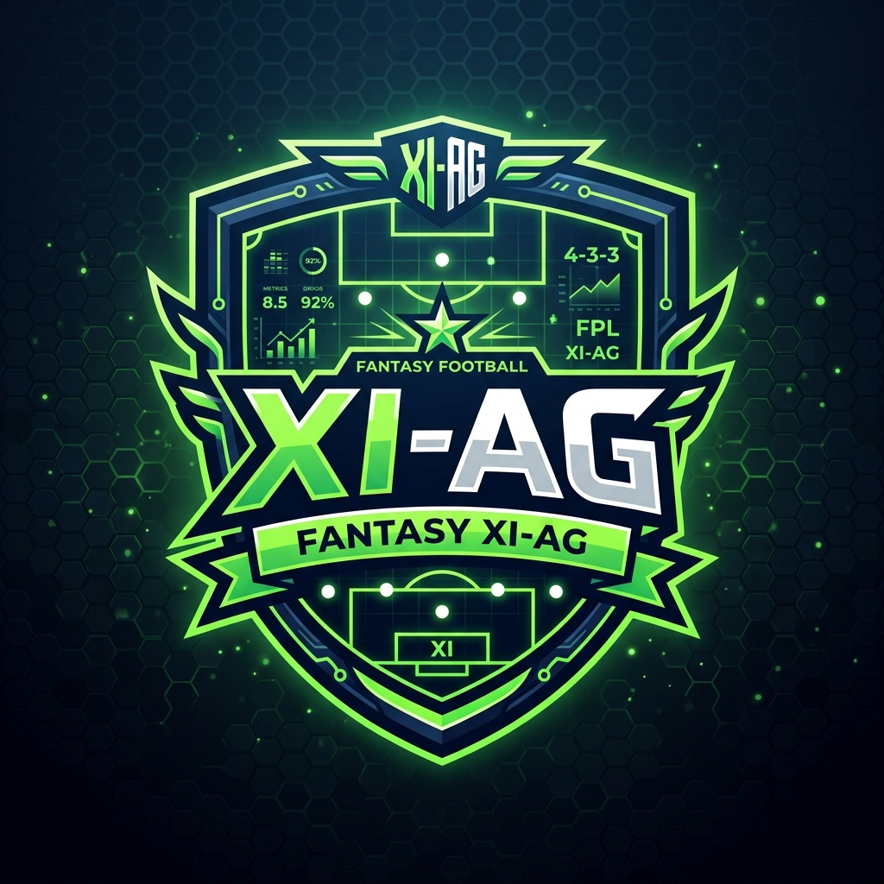
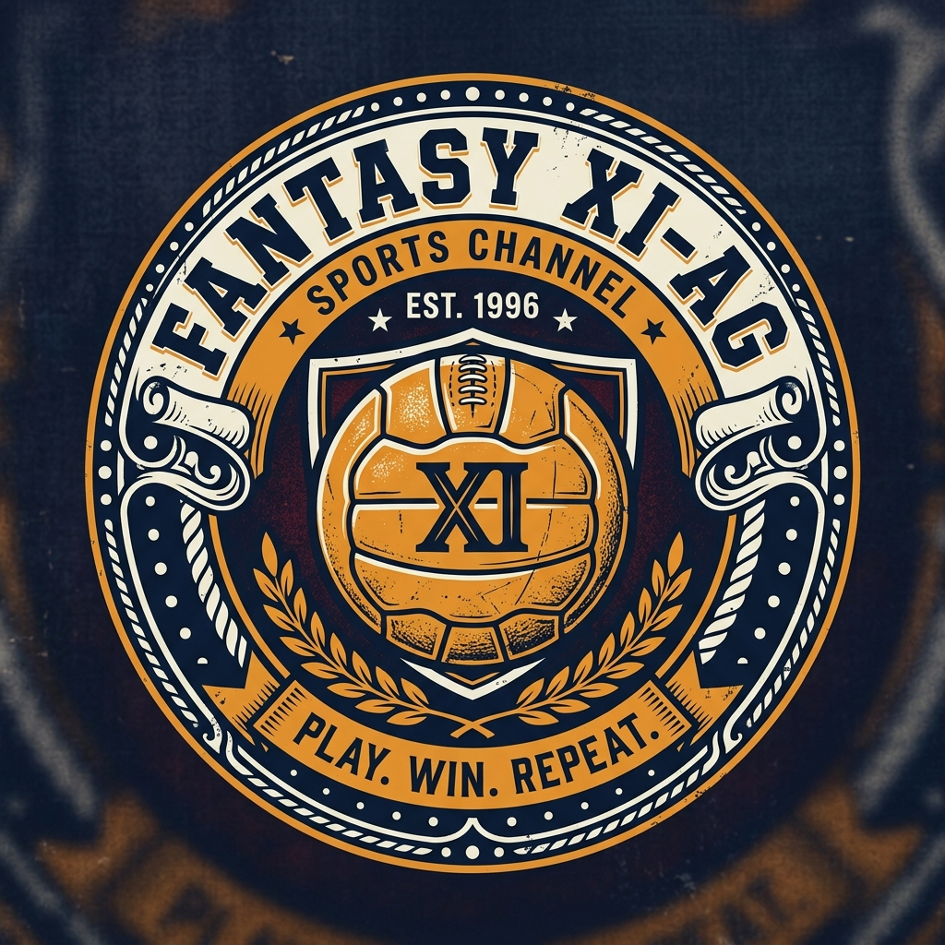
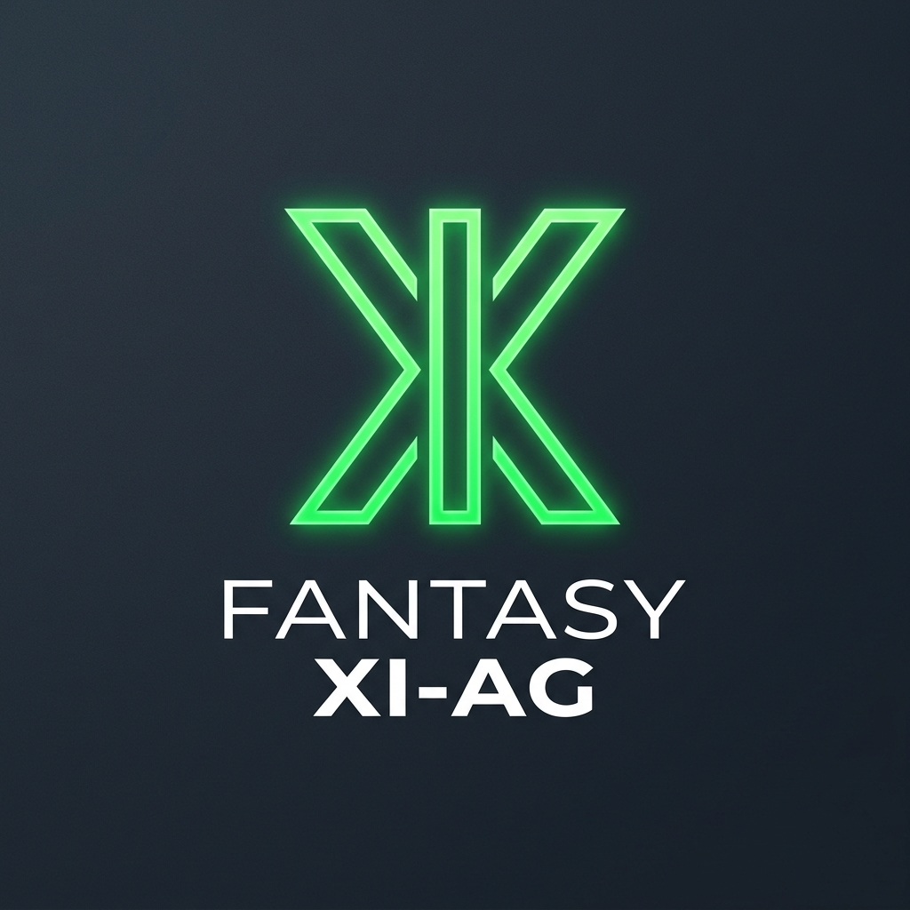
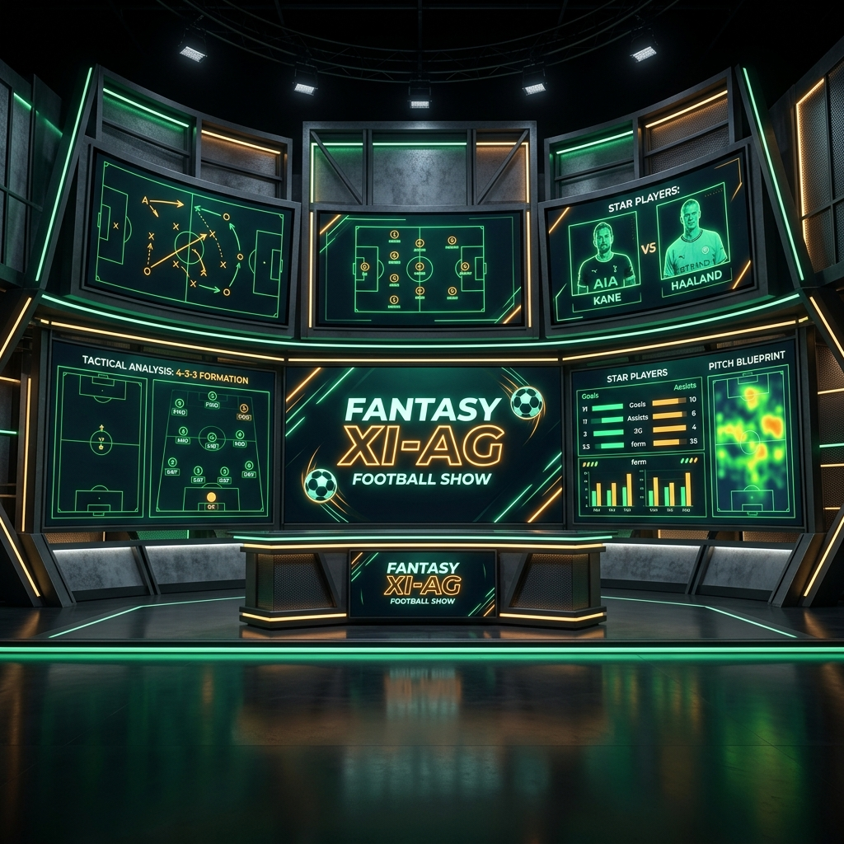
FANTASY XI-AG BRAND DECK
VISUAL ASSETS & MOCKUP OPTIONS
Select from 3 distinct generated logo styles. We have also generated the master analyst backdrop.
Master Analyst Backdrop
Premium dark-mode screen backdrop for studio green screens or video overlays.
Option 1: Esports Shield
Option 2: Retro Crest
Option 3: Minimal Monogram

Slide 6
FANTASY XI-AG BRAND DECK
ENVATO ELEMENTS SEARCH & LICENSING
VIDEO ASSETS & GRAPHICS
• Video Intros / Openers
Search Keywords: `esports intro dynamic`, `sports broadcast package`. Look for high-BPM glitch slide templates, customize tint colors to Navy and Pitch Green.
• Stinger Transitions
Search Keywords: `sports stinger transition`, `glitch wipe`. Use 0.5-second fast logo-swipes to separate talking segments.
• Lower Thirds / Stat Cards
Search Keywords: `sports lower third`, `football player card`. Translucent dark slate background card templates for player stats overlay.
AUDIO & SOUND EFFECTS
• Background Music Tracks
Search Keywords: `sports trap beat`, `dark cyberpunk action hip hop`. Choose loopable tracks at 120-140 BPM with heavy bass kicks. Play low underneath voice.
• Sound Effects (SFX)
Search Keywords: `whoosh transition`, `digital glitch sound`, `stadium roar`. Place whooshes when stat boxes slide in; crowd swells when LOCK is declared.

Slide 7
FANTASY XI-AG BRAND DECK
LAUNCH CAMPAIGN CALENDAR
Date | Instagram Reels | YouTube Shorts | YouTube Long-Form | Daily Theme
June 10 (Day 0) | Reel: Channel Intro | Short: Channel Intro | Video: MD1 Masterclass Draft | Channel Launch
June 11 (Day 1) | Story: Countdown & Lineups | Short: Rolling Captaincy Hack | None | Opener Deadline
June 12 (Day 2) | Reel: MD1 Points Review | Short: 3 Players to Watch | None | MD1 Reactions
June 13 (Day 3) | Carousel: Clean sheet paths | Short: Sasta aur Tikau (Budget) | Video: MD2 Transfer Targets | Defensive Swings
June 14 (Day 4) | Reel: 3 Punts of MD2 | Short: Door Raho Traps | None | Differential Hunting
June 15 (Day 5) | Story: Polls on MD2 Captains | Short: Safe vs Punt Captains | Video: MD2 Final Team Reveal | Captaincy Battles
June 16 (Day 6) | Story Q&A: Team Sudhaaro | Short: Quick Viewer Draft Fixes | None | Viewer Team Reviews

Slide 8
FANTASY XI-AG BRAND DECK
CONTENT SCRIPTS (HINGLISH)
SCRIPT 1: CHANNEL INTRO
"Dosto, World Cup Fantasy kal se shuru ho raha hai, aur is channel pe hum isko bilkul simple rakhne wale hain. Koi lambi kahani nahi, koi boring spreadsheets nahi. Papa Ranjeet aapko har matchday se pehle 3 simple calls dega: 1. Ek Tension-free Lock pick (points ki guaranteed delivery) 2. Ek Punt (risk hai toh ishq hai, low owned but high points) 3. Aur ek Avoid player jisse bilkul door rehna hai! Save this video right now! Comments mein 'DRAFT' likho ya team DM karo, match se pehle final draft ready kar denge. Maza aega!"
SCRIPT 2: ROLLING CAPTAINCY HACK
"World Cup Fantasy ka sabse bada hack pata hai? Rolling Captaincy! Standard FPL jaisa nahi hai bhaiya. Yahan agar aapka Day 1 ka captain blank jata hai, toh aap use badal kar Day 2 wale player ko captain bana sakte ho. Isliye apni draft team mein do clear captaincy options rakho. Day 1 pe kisi high-upside attacker pe punt lo—opener match ke star. Chal gaya toh badhiya, varna Day 2 pe Messi ya Mbappe ko armband de dena! Rules strategy ko details mein samajhne ke liye comment karo 'CAPTAIN' aur follow dabao!"

